Slide 1
Overview
Review被 … 吸引了
Use 被…吸引了in a sentence.
Use the above structure with vocabulary introduced in this unit
Introduce连…都… (what, when, and how)
Guided practice
Self directed exercise

Slide 2
被 … 吸引了
being attracted by …

Slide 3
Review
In passive sentences, the object of an action becomes the subject of the sentence, and what would have been the subject of the normal (active voice) sentence, the "doer" of the action, becomes secondary, and may or may not be included in the passive sentence.

Slide 4
Use 被…吸引了in a sentence.

Slide 5
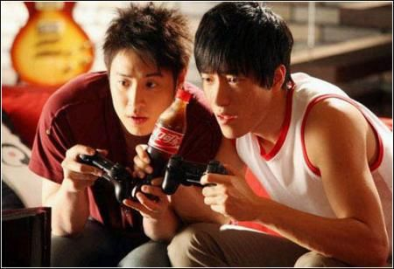
被…吸引了
http://cimg2.163.com/2008/2007/9/12/200709121411351a608.jpg
Notes:
General …

Slide 6
被…吸引了
http://soccer-prof.com/wp-content/uploads/2012/07/Watching-soccer.jpg

Slide 7
被…吸引了
http://viphairstyles.com/wp-content/uploads/2011/10/Long-Auburn-Brown-Hairstyle.jpg
Notes:
hair

Slide 8
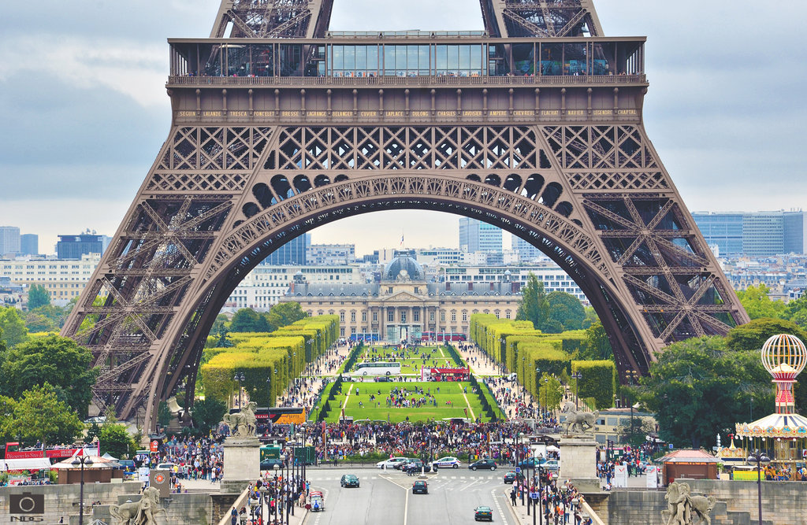
被…吸引了
http://fc02.deviantart.net/fs70/i/2011/258/3/c/elf_tower_ii_by_tars1s-d49w76r.jpg
Notes:
Feature about Julie Roberts

Slide 9
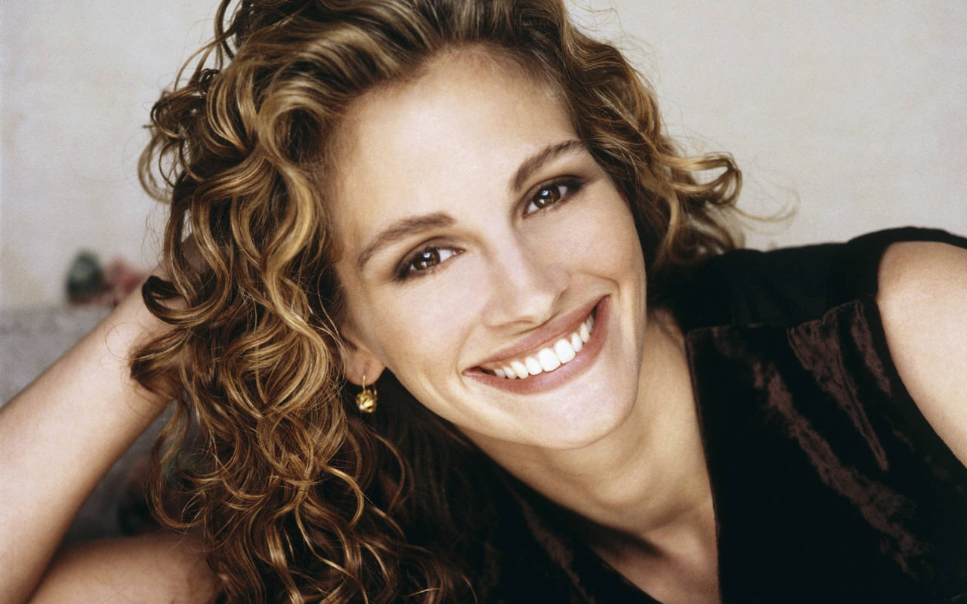
被…吸引了
英俊
幼稚
成熟
温柔
浓眉
活泼
有礼貌
体贴
天真
http://images.fanpop.com/images/image_uploads/Julia-Roberts-julia-roberts-742865_1280_800.jpg
Notes:
Feature about Julie Roberts

Slide 10
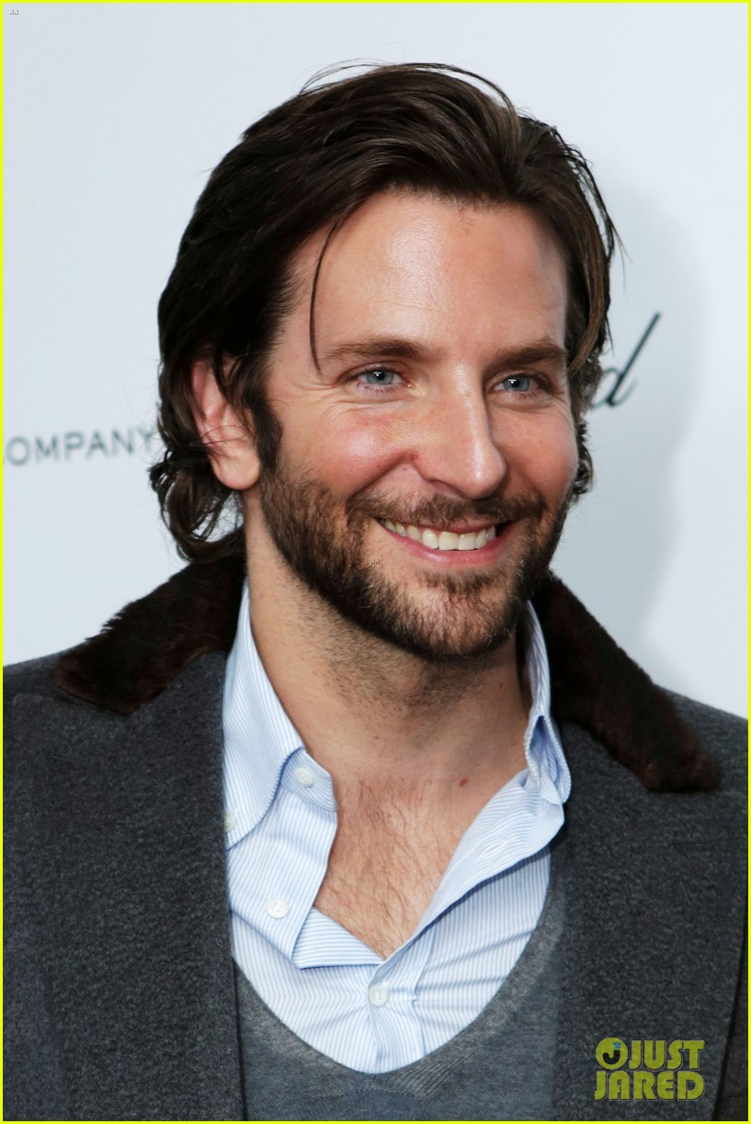
被…吸引了
英俊
幼稚
成熟
温柔
浓眉
活泼
有礼貌
体贴
天真
http://cdn01.cdn.justjared.com/wp-content/uploads/2013/02/cooper-weinsteinpre/bradley-cooper-robert-de-niro-weinstein-pre-oscars-party-2013-02.jpg
Notes:
handsomeness

Slide 11
被…吸引了
英俊
幼稚
成熟
温柔
浓眉
活泼
有礼貌
体贴
天真
http://www.wallbest.com/wallpapers/2560x1440/cute-little-baby-girl.jpg
Notes:
天真

Slide 12
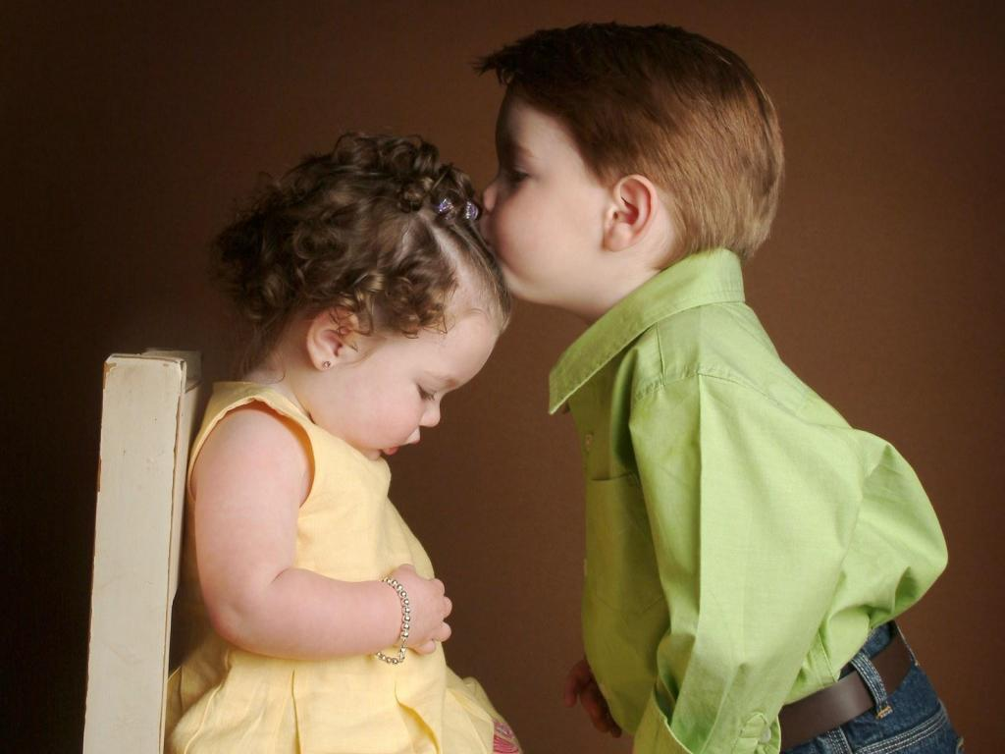
被…吸引了
英俊
幼稚
成熟
温柔
浓眉
活泼
有礼貌
体贴
天真
http://www.wallsave.com/wallpapers/1024x768/cute-child-people-children/61771/cute-child-people-children-baby-pictures-free-61771.jpg
Notes:
天真

Slide 13
被…吸引了
英俊
幼稚
成熟
温柔
浓眉
活泼
有礼貌
体贴
天真
http://img0.fumuhui.com/20120427/1/2012042709284870291.jpg
Notes:
活泼

Slide 14
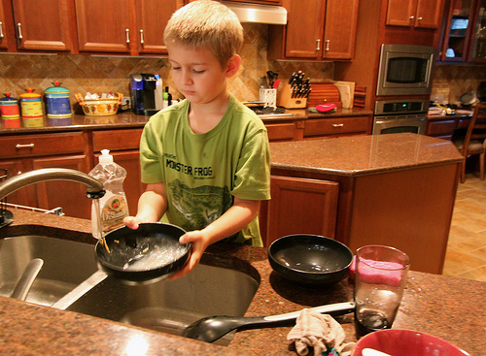
被…吸引了
英俊
幼稚
成熟
温柔
浓眉
活泼
有礼貌
体贴
天真
http://nspt4kids.com/wp-content/uploads/2012/08/200283545-001.jpg
http://home.yourway.net/files/2012/02/chores-for-kids.jpg
Notes:
Maturity

Slide 15
连…都…
连 N 都 V

Slide 16
When to use this structure
The meaning of 连……都（也）… is to express emphasis
In Chinese, the conjunction 连 is often used to introduce the element that is to be emphasized, showing that even what is emphasized is so, it goes without saying other case.

Slide 17
How to use this structure
The emphasized elements should be placed between 连 and 都.
Objects of the conjunction 连 can either be words or phrases.
For example:

Slide 18
连…都… (emphasis on 中文)
“中文”放在句子的什么部分？
用什么动词？
想说的内容是什么？是肯定句(positive)还是否定句(negative)？

Slide 19
连…都… (例句)
他连中文都会说。
他连地图都找到了。
他连老师都请来了。
他连中文字都不会写。
他连去哪里休假都不知道。
他连他的好朋友都没有告诉。

Slide 20
how to use this structure
The stress is on the element to be emphasizes between 连 and 都.

Slide 21
连…都…
他连中文都会说。
他连地图都找到了。
他连老师都请来了。
他连中文字都不会写。
他连去哪里休假都不知道。
他连他的好朋友都没有告诉。

Slide 22
Use the 连…都… structure and the picture to make two meaningful sentences, one positive, and one negative.

Slide 23
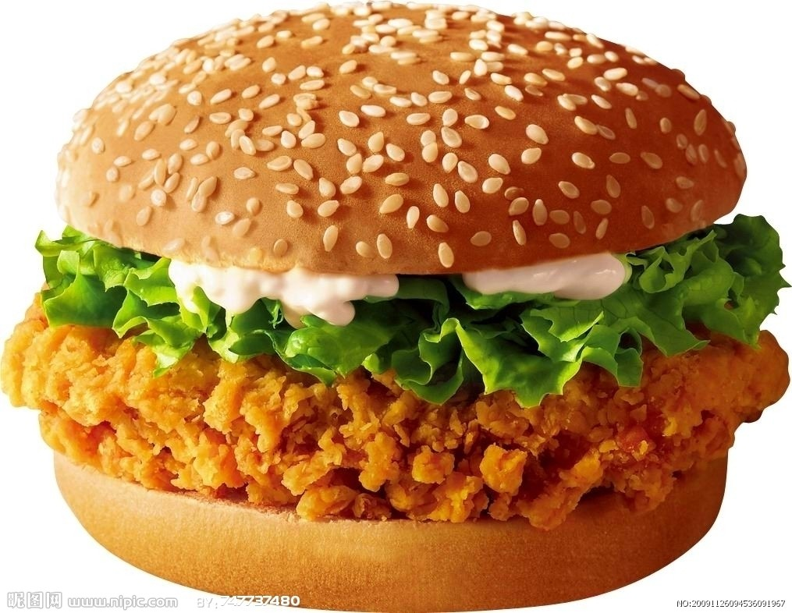
连…都…
http://pic4.nipic.com/20091126/2359039_094536091967_2.jpg

Slide 24
连…都…
http://i1075.photobucket.com/albums/w429/tu2028/drinking-water-promotes-weight-loss_zps93f908d8.jpg

Slide 25
连…都…
http://thumbs.dreamstime.com/z/shocked-asian-businessman-1411484.jpg

Slide 26
连…都…
http://smallbizradicals.com/wp-content/uploads/2012/07/3578332-standardized-quiz-or-test-score-sheet-with-multiple-choice-answers.jpg

Slide 27
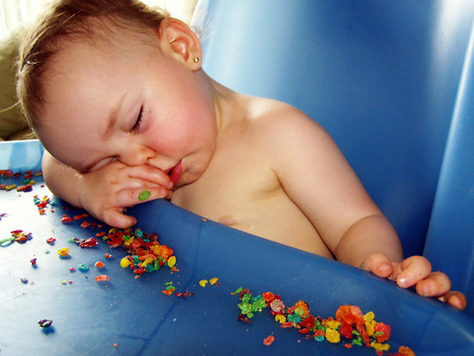
连…都…
http://ih3.redbubble.net/image.5790356.8749/flat,550x550,075,f.jpg

Slide 28
连…都…
http://beta.images.theglobeandmail.com/3ed/incoming/article827314.ece/ALTERNATES/w620/web-damage.jpg

Slide 29
连…都…
http://hdwallpapersgallery.com/wp-content/uploads/2013/02/angry-child-pics.jpg

Slide 30
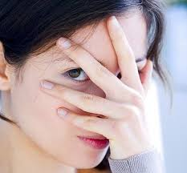
连…都…
https://encrypted-tbn2.gstatic.com/images?q=tbn:ANd9GcRNN8_ABfysQC8zzGNvxSOlHXvIOW7DeYxFr551IThEtRaBgSrN

Slide 31
连…都…
http://livemall.blob.core.windows.net/moviesimages/MovieBackdrop/Original/1232674.jpg
Notes:
extension

